Slide 1
Challenge Theme
Create an innovative solution to protect sensitive data from cyber attacks and ensure data privacy
Team name: nerds of many hats
Teammates: Maharsh Patel
Deuknam Kim
Michele Y M Chan
Alvis Chong

Slide 2

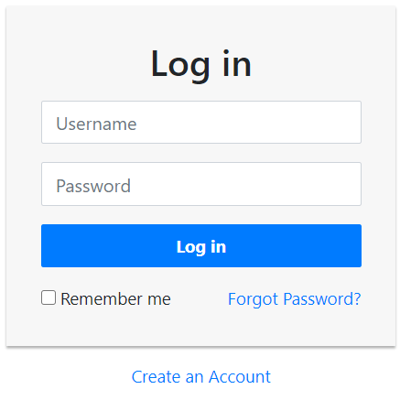
Access points are vulnerable

Slide 3
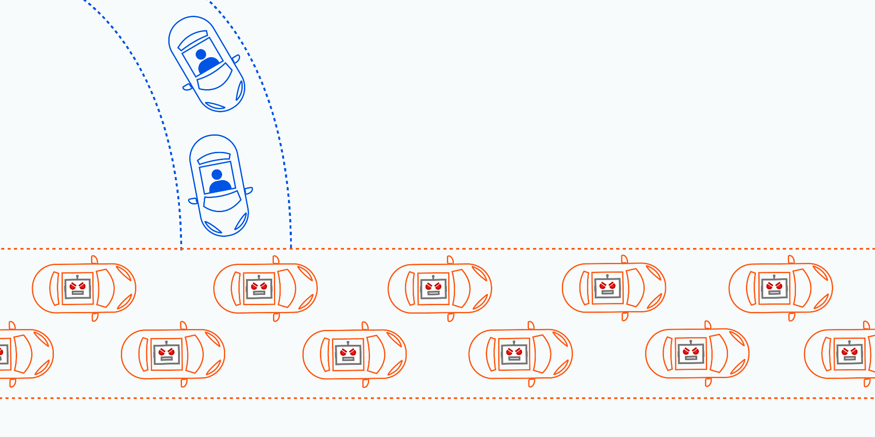
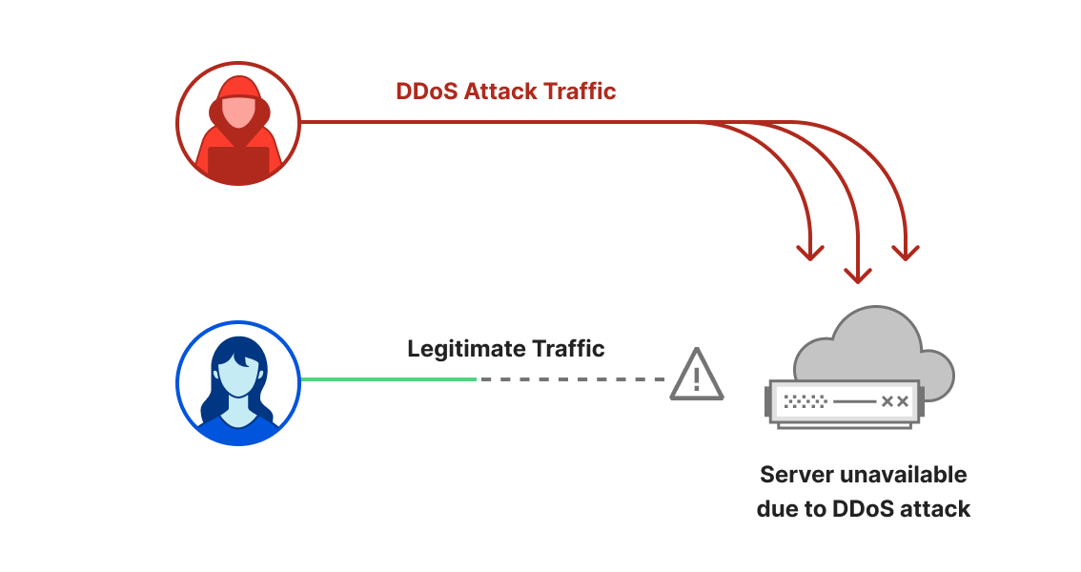
DoS\DDoS (Distributed-Denial-of-Service) attack disrupts the normal traffic of a targeted server.
Source link: https://blog.cloudflare.com/ddos-threat-report-2023-q2/
https://www.cloudflare.com/en-ca/learning/ddos/what-is-a-ddos-attack/

Slide 4
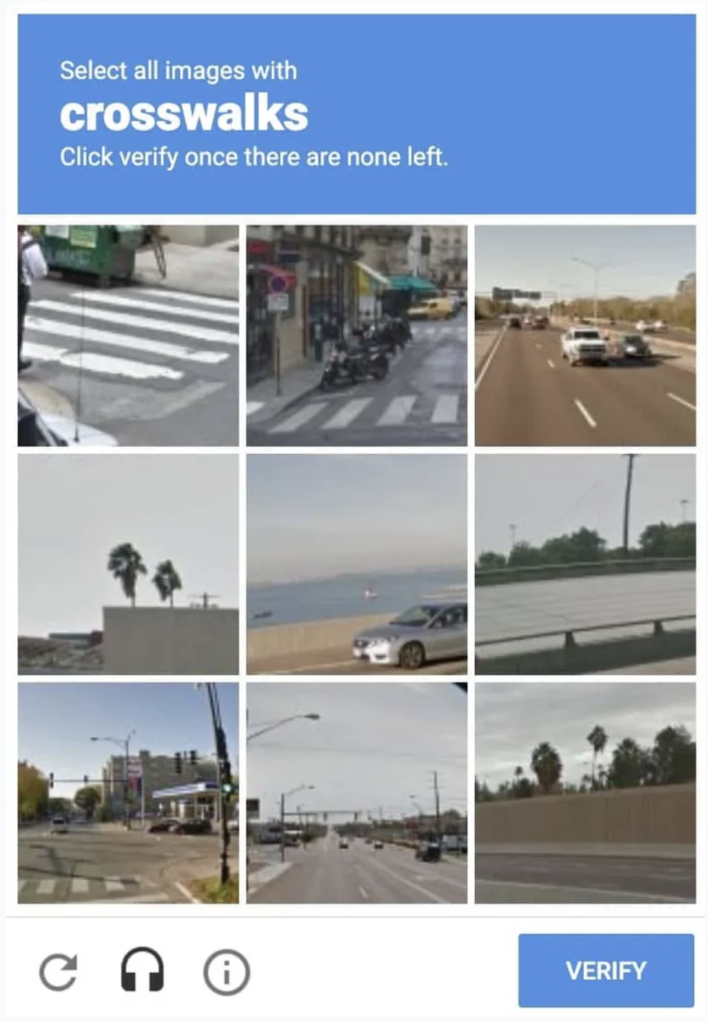
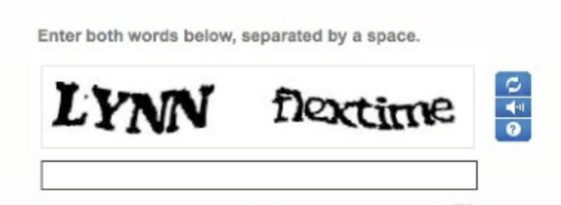
Captcha
AI bots can solve text-based CAPTCHA tests correctly 100% of the time.
AI bots can solve image-based CAPTCHA tests correctly 85% of the time.
Source link: https://www.usatoday.com/story/tech/2023/08/17/captcha-tests-keep-more-humans-than-bots-out-study-shows/70609691007/

Slide 5
Solution
A Defence against DoS\DDoS using Image Processing and Machine Learning

Slide 6

AI vs AI

Slide 7
Solution Overview
Users can set their own unique hand sign or gesture with movement to login.
Neural Network gets trained to detect individuals preset hand signs.
It can be used along with the username and passwords for added security.

Slide 8
DEMO

Slide 9
Questions?

Slide 10
spear information
Face ID doesn’t require light to function (people can unlock the phone in dark)
https://discussions.apple.com/thread/8591584#:~:text=I%20Face%20ID%20doesn't,you%20would%20during%20daylight%20hours.
Apple’s Face ID designed to work indoors, outdoors and even in total darkness.
Siblings, twins and children can sometimes access(unlock) family members' iPhones using FaceID
https://www.cbc.ca/news/canada/thunder-bay/first-person-face-id-apple-phones-1.6829342#:~:text=Siblings%2C%20twins%20and%20children%20can,family%20members'%20iPhones%20using%20FaceID&text=When%20my%2010%2Dyear%2Dold,Face%20ID%20welcomed%20him%20in.
Many phones that can be unlocked using facial recognition can be fooled by a photograph, research has found. According to consumer body Which?, scammers can bypass the screen lock on certain Android phones and access sensitive information.
https://www.forbes.com/sites/emmawoollacott/2023/05/19/many-android-phones-can-be-unlocked-with-a-photo/?sh=3b0e346c535a

